Slide 1
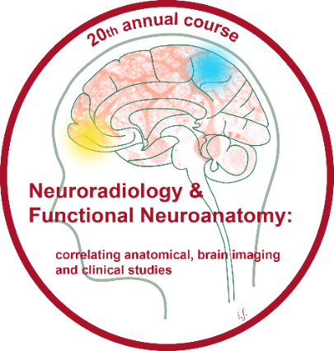
Neuroradiology & Functional Neuroanatomy Course 4-7 July 2022 Queen Square, London
This four day course will correlate gross anatomy with neuroimaging and functional MRI to illustrate normal neurological function, the alterations that attend disease, and the bases for the clinical features seen in patients.
Course Organisers:
Prof Thomas Naidich
Mount Sinai School of Medicine, New York USA
Prof Christopher Yeo
Department of Neuroscience, Physiology & Pharmacology, University College London UK
Prof Tarek Yousry
Division of Neuroradiology, UCL Institute of Neurology, London UK
Further information can be found at https://www.ucl.ac.uk/ion/events/2022/jul/20th-annual-course-neuroradiology-functional-neuroanatomy-4-7th-july-2022 or email Soledad s.dotor@ucl.ac.uk

